Slide 1
Distributed cum Hierarchical Client Server Architecture for Core Banking System
Submitted By
Satyam Sevanya (15CS10040)

Slide 2
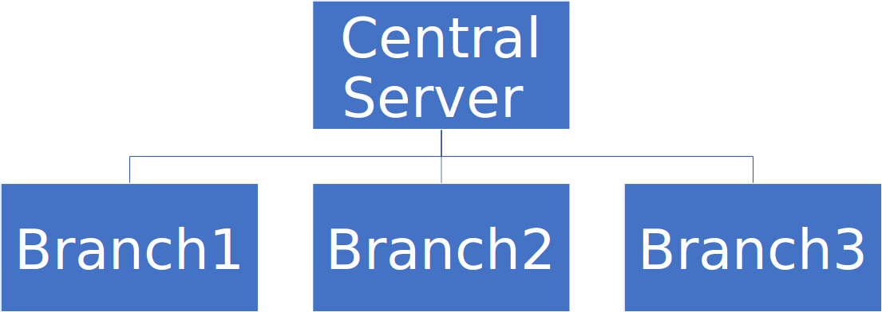
Sample Model

Slide 3
Local Transactions
All transactions between local users can be performed smoothly irrrespective of the fact that central server link is up or not.
If central server link is up and not busy then local transaction details can be updated to central server otherwise data can be updated after bank office hours.

Slide 4
Implementation
Central Server is running all the time
It uses sockets to accept connections from branches and communicate branch servers

Slide 5
How to create Account

Slide 6
Atleast one of Aadhar and PAN is compulsory.
Atleast one of Signature and Biometric is compulsory.
Details first sent to Central Server which stores details in MySQL database and allocates ID (Acc No).
Branch(Client) receives ID from Central Server and stores User Details in its Database.
ACCOUNT CREATED SUCCESSFULLY

Slide 7
How local transactions work

Slide 8
Branch database check details and proceed.
User can deposit money - Branch adds money in local database.
User can view balanace - Branch shows balance in local database.
User can withdraw money - Branch looks into database for enough balance and perform transaction.
TRANSACTION SUCCESSFUL

Slide 9
How data updated to central server

Slide 10
If central server link is up and not busy ?
Branch(Client) sends local transaction details to central server via socket.
Else
Branch sends data to Central Server via sockets after bank office hours.

Slide 11
Thank You

